Slide 1
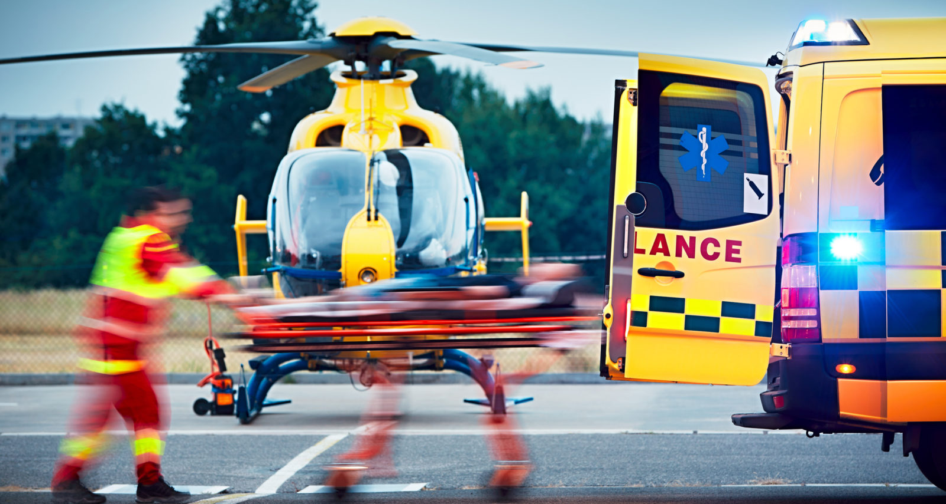

Response 101: Predicting EMS Call Locations For Strategic Ambulance Allocation
MUSA 507
Team EMS
Anthony Ayebiahwe, Steven Chang
Notes:
Hi. We are Team EMS. In this video, I will be talking about the EMS Responder app that we developed, as well as the predictive model that powers it.

Slide 2
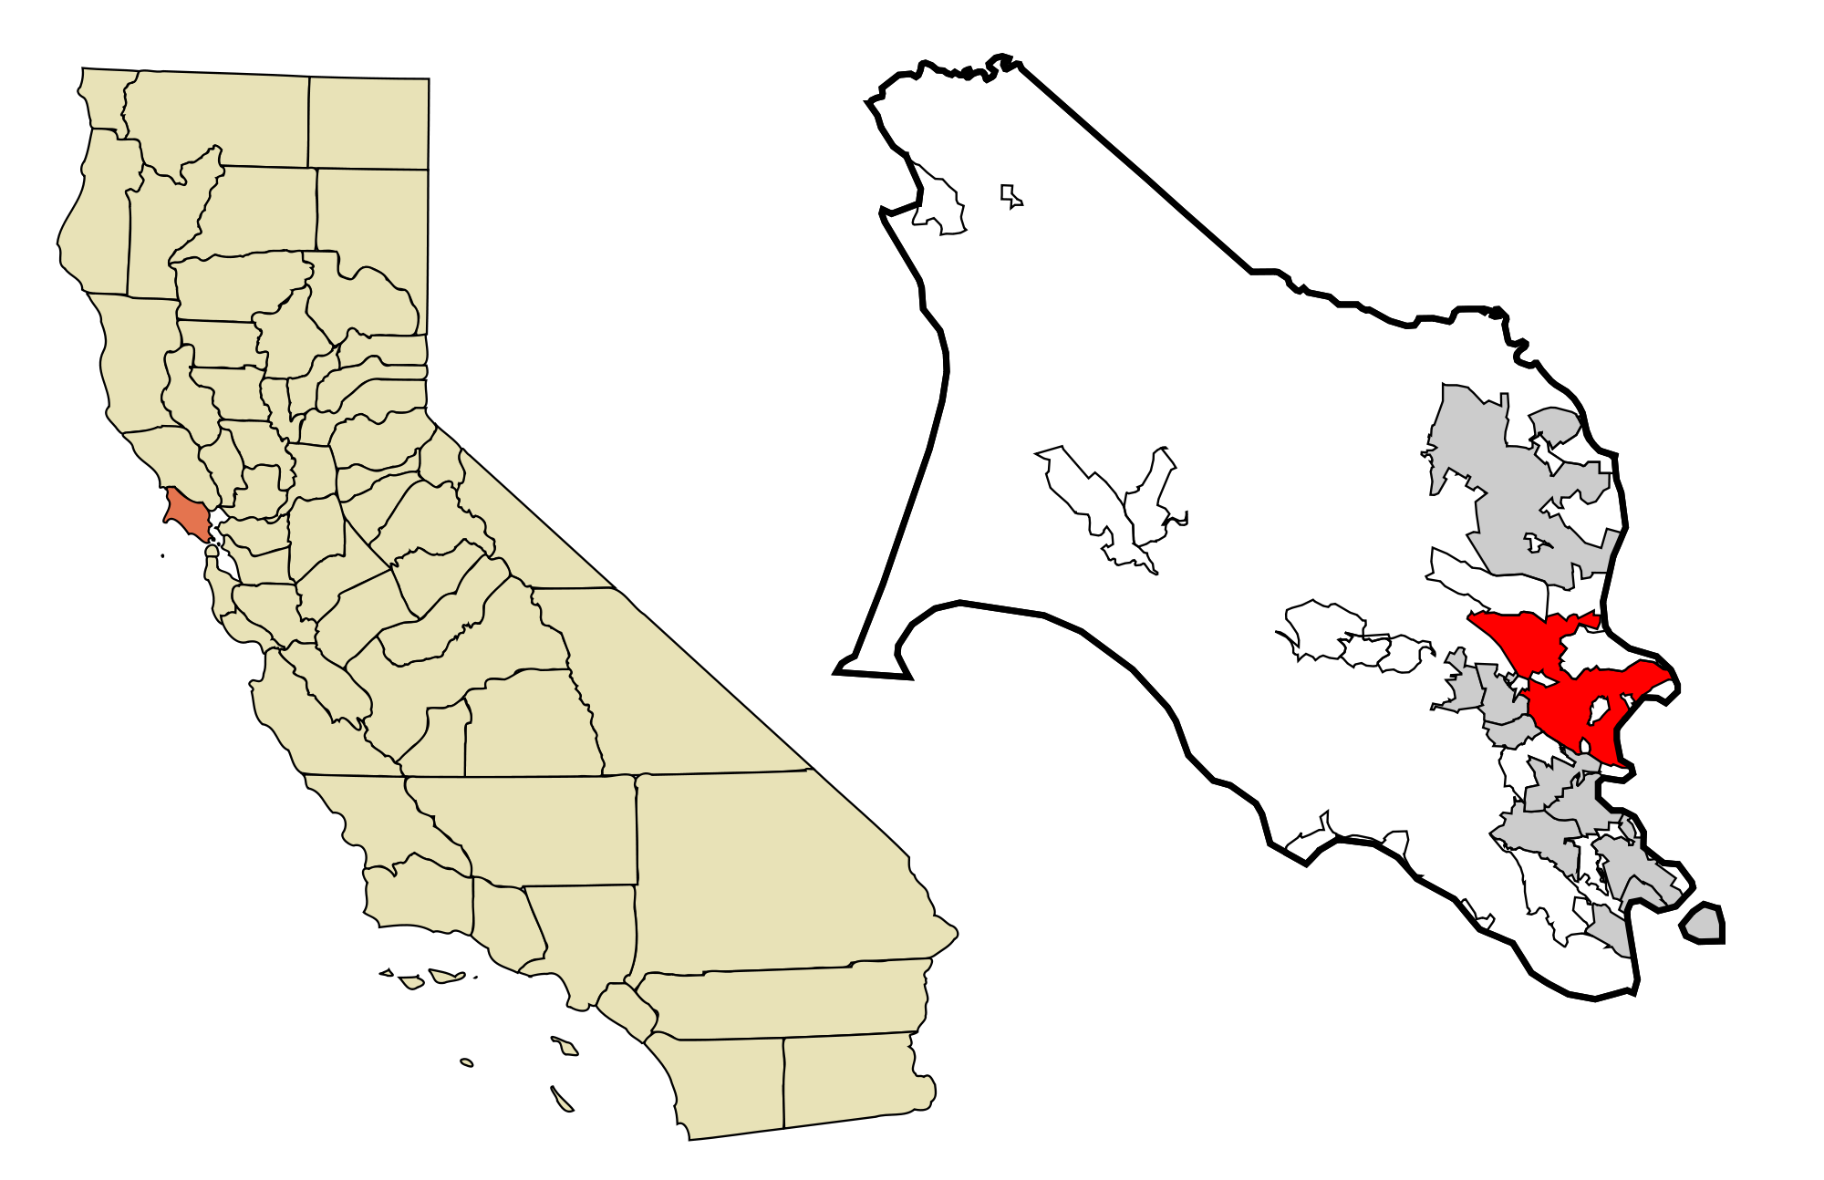
Overview
Nobody wants to run into an emergency, call an ambulance, then having to wait forever for help to arrive
Introducing the Responder app
Designed for EMS responders
Powered by a predictive model for EMS call volume across space in Marin County, California
Notes:
As an overview, nobody wants to run into an emergency, call for help, then having to wait forever, leading to the policy question of: Can we predict the locations of EMS calls such that EMS responders can strategically post in certain locations before an emergency arises, such that when one does occur, response times can be minimized. This is where the Responder app comes in. It is designed for EMS responders to enhance the strategic resource allocation and improve response times in Marin County, California.

Slide 3
Use Case + Motivation
Over 20% of EMS calls in San Rafael, Marin County resulted in delayed responses
Policy question: Can we predict the locations of EMS calls such that ambulances and EMS units can be strategically positioned to shorten response times
Data Collection
Model Prediction
Field Execution
Call placed
Analyzed by algorithm
Standby location pushed to responders
Call location logged
Predictions made
Received call in predicted location
Data point collected
Standby locations determined
Faster response
Notes:
The motivation behind our algorithm is to try to get help to people who need it as quickly as possible. Shorter wait times can mean better chances of survival for patients. Here is a use case demonstration for our algorithm. When an EMS call is placed, the location information is collected, which feeds into the model that predicts future EMS call locations based on where these calls occurred in the past. This will allow responders to identify higher risk areas so they can respond accordingly.

Slide 4
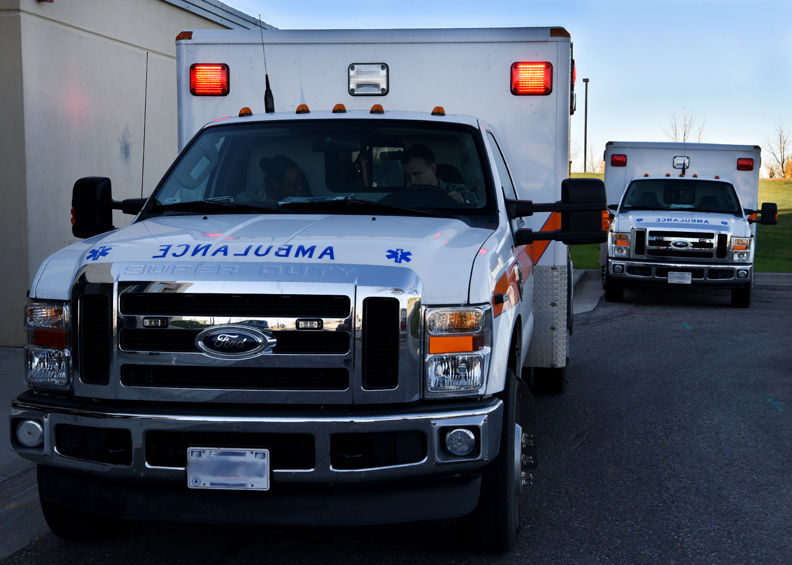
Current Decision-Making Process
Call placed and routed to dispatcher
Dispatcher gets general idea of emergency and determines resources needed based on his/her best judgement
Dispatcher contacts teams with the necessary resources to respond
Intermediary communications, overwhelmed or underutilized resources may cause delays
In real emergencies these delays may pose serious life-or-death situations
Notes:
In the current decision process, when a 911 call is placed, it is routed to the dispatcher, who gathers information from the caller and decides the necessary resources to respond to the incident. The dispatcher then contacts the teams with those resources to respond. There is a lot of intermediary communications going on, and if limited resources are overwhelmed or strained by other incidents, this can result in delays. In real emergencies, these delays may pose serious life-or-death situations for the victims.

Slide 5
Outcome of Interest
Faster response times, get patients to necessary care quicker
Less stress scrambling resources together when emergency arises
Maximizes use of limited resources
Sounds appealing? It should
Notes:
The outcomes of interest for our algorithm are faster response times to get victims to the care they need, less stress for EMS crew responding to emergencies, and maximizes use of limited resources by optimizing its allocation. We hope to take a more proactive approach to EMS to foster a safer community, with happier residents and also making the jobs of EMS crew more manageable

Slide 6
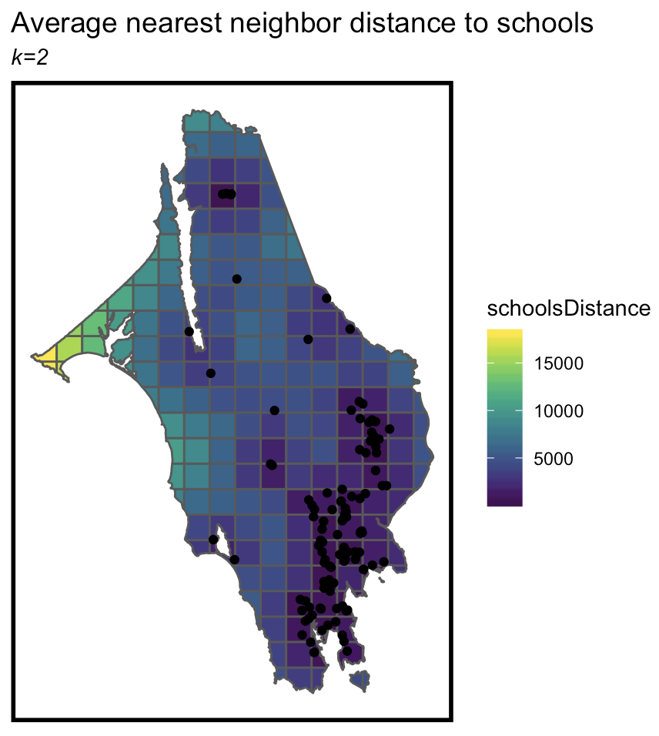
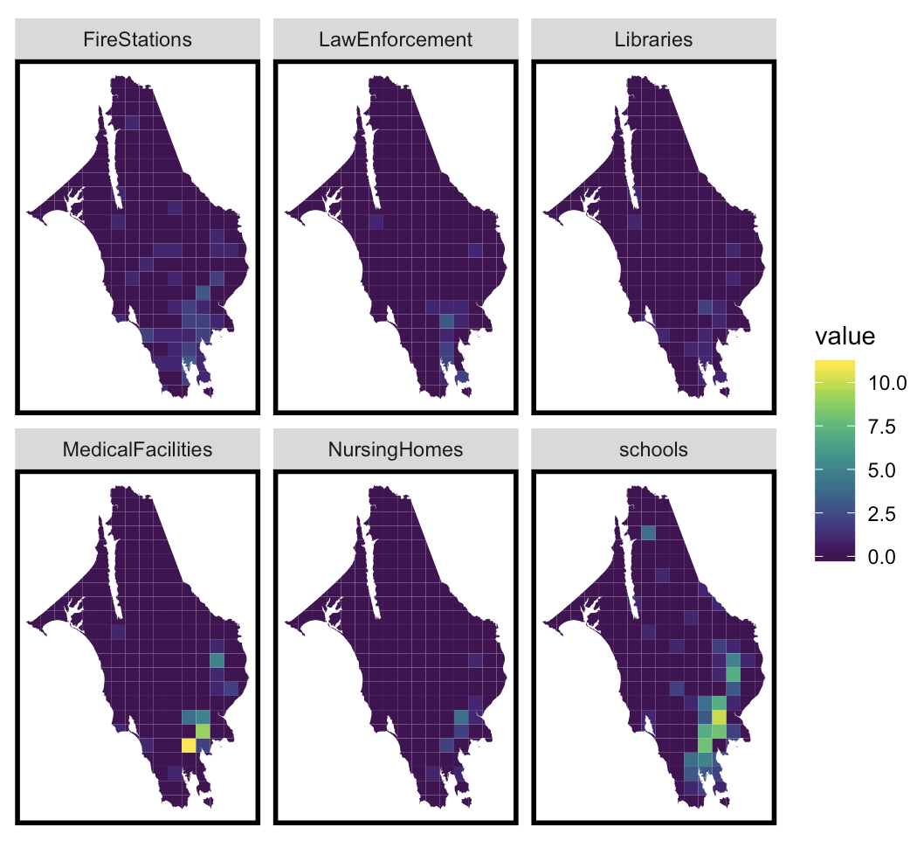
Inputs and Data Wrangling
Emergency incidents data from Marin County open data source
Marin County schools, libraries, nursing homes, medical facilities, law enforcement, and fire stations
Data wrangling
Divide Marin County into fishnet cells
Aggregate call count in each cell
Wrangle all facilities into the same fishnet
Feature-engineer distance variables
Notes:
The primary dataset we used is the emergency incidents data from the Marin County open data website. We also included data on the locations of schools, libraries, nursing homes, medical facilities, law enforcement, and fire stations within the county as predictor variables. We first divided Marin County into a series of fishnet cells and aggregated the call count in each cell. We then wrangled all facilities locations into the same fishnet and feature-engineered distance variables as additional predictors. The maps here show some of this information for our predictor variables.

Slide 7
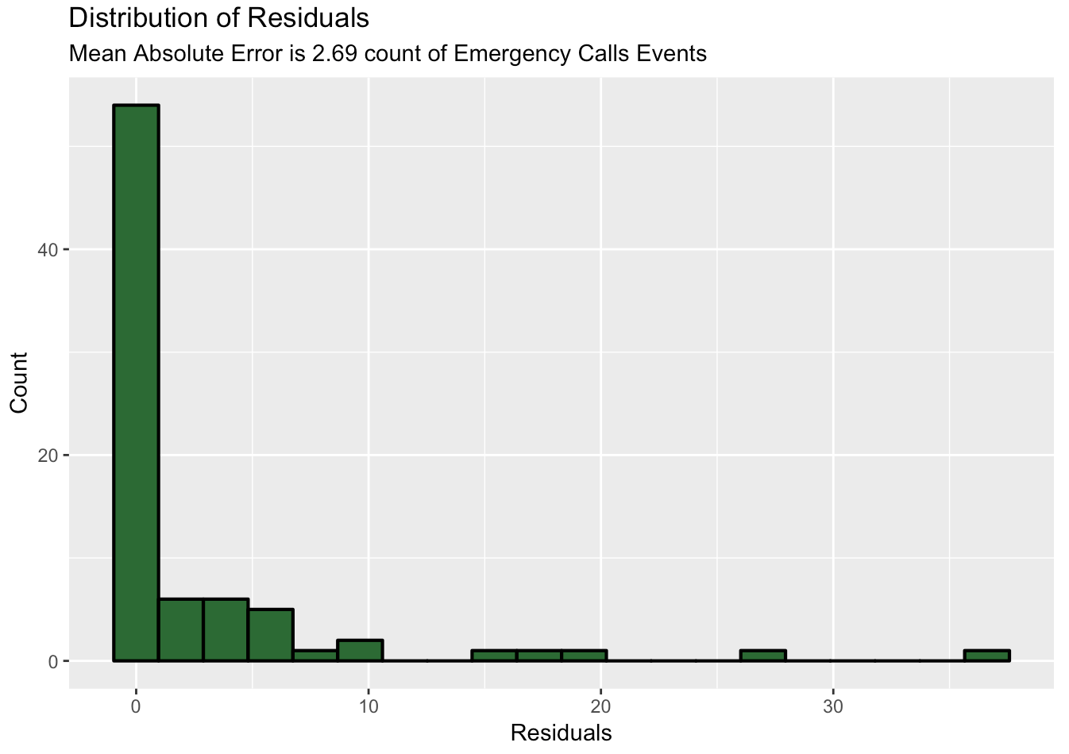
Modeling Validations
Poisson regression model with number of calls in a given space as the dependent variable
Spatially-dependent test sets
Train data using 60% of calls to test on remaining 40%
Use mean average error to evaluate the model
Notes:
We built a Poisson regression model with the number of calls in each fishnet as the dependent variable. We selected this model because we are modeling a rare event that does not follow a linear distribution. We validated our model using spatially-dependent test sets, using a training set of 60% of all EMS calls and a test set on the remaining 40%. We then used the mean average error metric to evaluate the performance of the model.

Slide 8
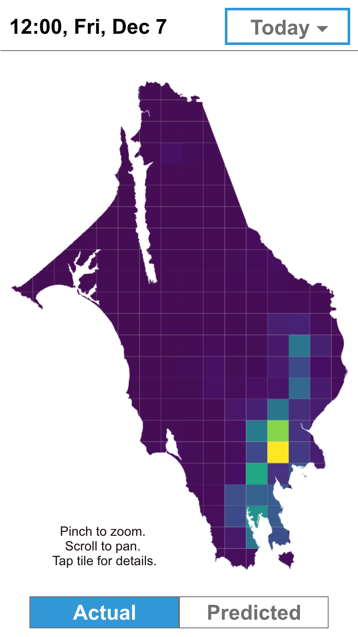
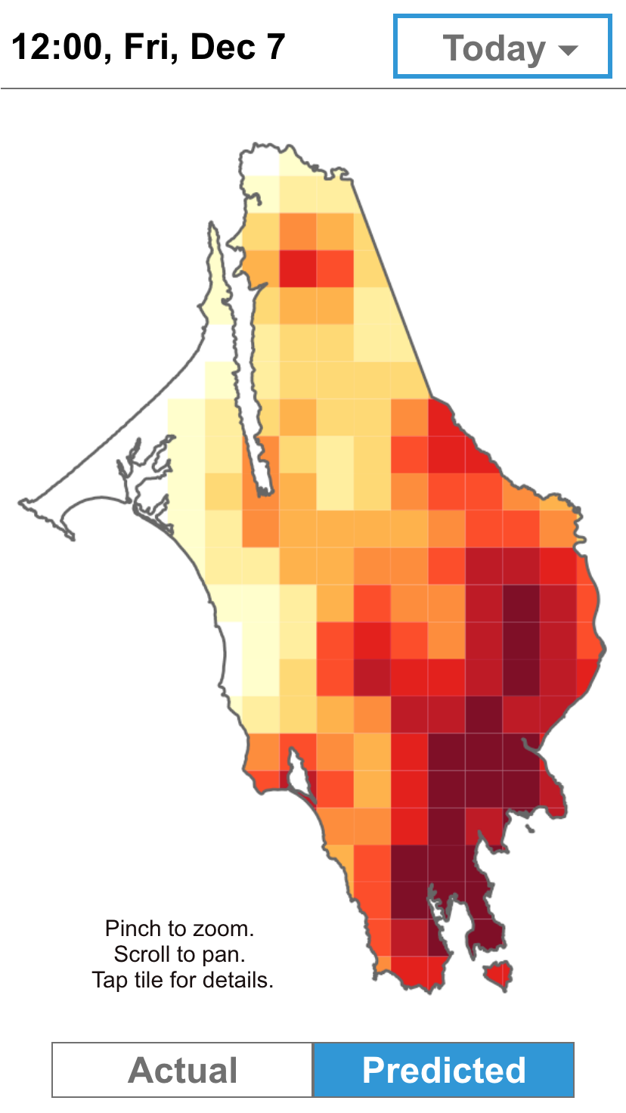
Meet the Responder App
Locations and distributions by times of past EMS calls at a glance
Easily compare how call occurrences may shift to identify potential patterns and trends
Notes:
Let’s talk about the Responder app. Here, we have the two main windows of the main application interface. The screenshot on the left shows the actual number of calls by fishnet across the county at the date selected, and the screenshot on the right shows the predicted risk levels for each fishnet. The user will also have the ability to pick any date using the dropdown menu at the top right corner.

Slide 9
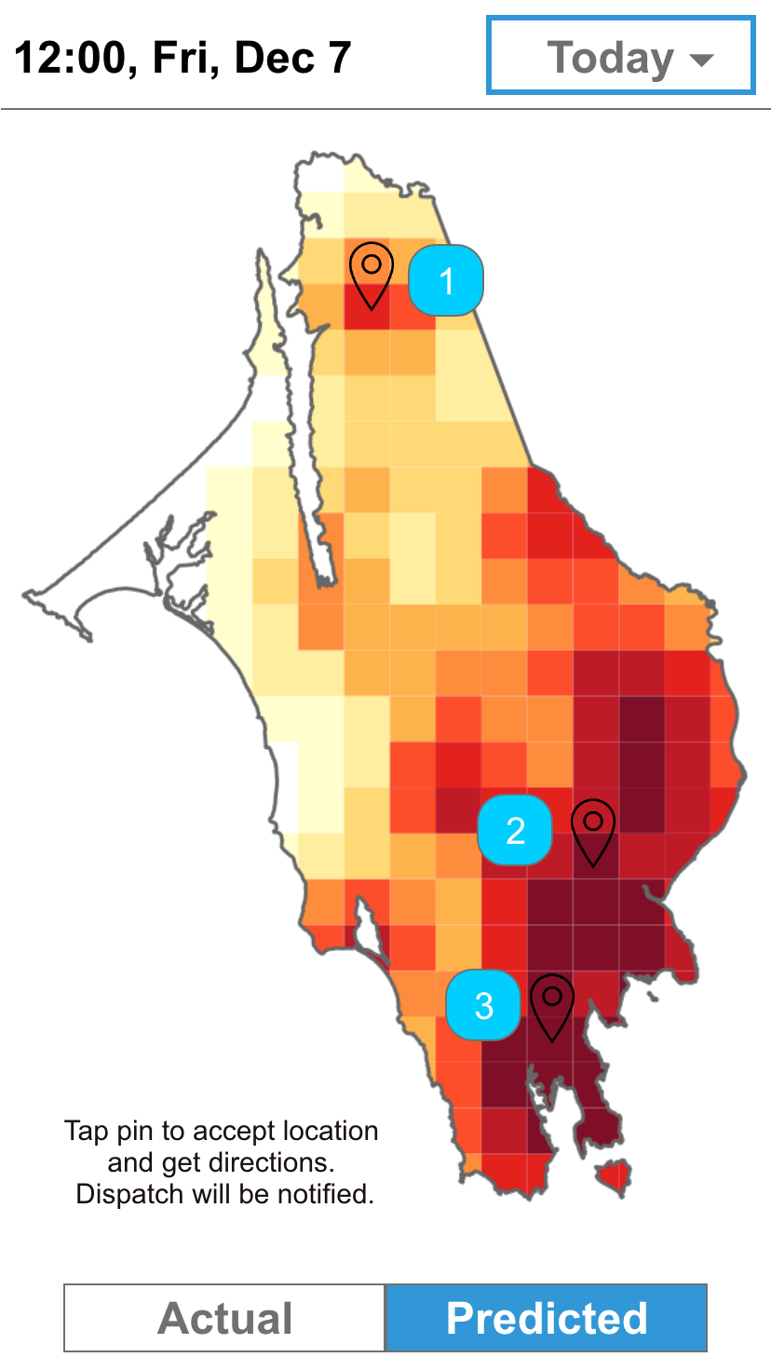
Additional Features: Standby Locations
Predicts where and when EMS calls may arise based on past data
Presents areas that are more likely to generate calls, and suggests those areas as potential standby locations
Users can accept locations to post in certain locations, which will update the system so dispatch and other responders will know if an area is already covered
Notes:
One feature we would like to include is the standby location suggestions. This feature uses the model-predicted risk levels to present areas that are more likely to generate EMS calls, and recommend standby areas for EMS responders that shortens response times for these areas. The EMS responder can then accept these suggested locations, and the system updates dispatch and other responders that a particular area has been covered. The map will update accordingly.

Slide 10
Additional Features: Routing
Calls and locations will be displayed in-app in real time, allowing responders on standby to accept and respond
Provides turn-by-turn navigations to the location of the call
Updates across the system to reduce latency and intermediary communication
Allows responders to quickly request for backup in-app as needed
Notes:
Another feature is a navigation system built into the app. When a call comes in and the location becomes available, the app displays it and allows responders on standby to accept and respond with a few taps. They will then receive turn-by-turn navigations to that location. Accepting a call and starting the navigation process will notify dispatch that the unit is already responding to a call, reducing latency and intermediary communication. Responders will also be given the option to request backup in-app as needed.

Slide 11
Future Improvements
Identify additional demographic and socioeconomic variables to improve predictive power of our model
Incorporates the ability to intelligently override traffic and one-way streets for navigation through all available roadways when sirens are activated
Notes:
Going forward, there are a couple improvements we can make. For the model, we wish to identify additional demographic and socioeconomic variables that may contribute to generating EMS calls to improve the predictive power of our model. On the app side, we wish to incorporate the ability for the navigation system to override traffic and road directions so responders with their sirens on can utilize all available roadway when responding to an emergency.

Slide 12
Thank you
Questions? Reach us at:
Anthony Ayebiahwe: aayeb@design.upenn.edu
Steven Chang: sbdchang@design.upenn.edu

